Slide 1

PhD Synopsis on
Efficient Machine Learning Techniques for Early Diagnosis of Alzheimer’s Disease
Submitted in Partial fulfilment of the requirement for the award of the degree of
Doctor of Philosophy
In
Computer Applications
By
P. Stanley
I.D. No: 17PHCOA201
Under the Supervision of
Dr. N. K. Gupta
DEPARTMENT OF COMPUTER SCIENCE & I.T.
VAUGH INSTITUTE OF AGRICULTURAL ENGINEERING AND TECHNOLOGY,
FACULTY OF ENGINEERING AND TECHNOLOGY
Sam Higginbottom University of Agriculture, Technology & Sciences
(Formerly Allahabad Agriculture Institute)
Prayagraj-211007. (U.P.) India

Slide 2
Outline
Introduction
Motivation
Review of Literature
Research Questions
Research Problems
Objectives
Materials & Methods
System Requirements
Proposed Methodology
Expected Outcomes
References

Slide 3
Introduction
Alzheimer’s Disease (AD) is a neurological disorder that causes the death of nerve cells in the human brain.
AD usually begins gradually and its first symptoms may be attributed to the increment of the age or common forgetfulness.
As the disease progresses, the patient’s cognitive abilities deteriorate, including the ability to make decisions and carry out daily tasks.
Early Alzheimer’s disease is characterized by the difficulty to remember newly acquired information since AD typically begins with affecting the part of the brain that is connected with our learning capabilities.
As the illness progresses, the symptoms become more severe and often result in symptoms such as disorientation, mood and even behaviour changes.

Slide 4
Continued…
Currently there is no cure for the disease, only a series of guidelines can be followed to perhaps delay the progress of it. For this reason, an effective diagnosis will be a key factor in order to improve the quality of life of the patients.
Alzheimer’s is a frequent type of dementia, which is considered as a main threat for the healthcare industry in today’s world.
Alzheimer’s disease can be clinically diagnosed by physical and neurological examination, which can be costly and time consuming.
Alzheimer’s symptoms generally develop slowly and get bad over time, which can become more severe and affect the daily activities (Alzheimer’s Association, 2019)
However, the early detection of this disease, before most of its symptoms are observable, is difficult. The prediction of Alzheimer’s at pre-symptomatic stages is recommended to slow down the disease progression.

Slide 5
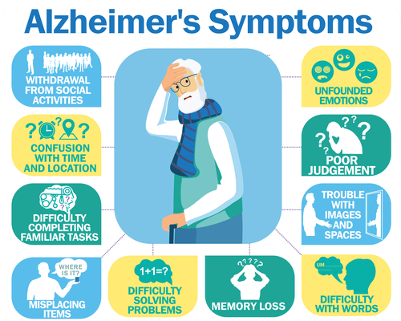
Continued…

Slide 6
Motivation
The patient’s having Alzheimer’s disease have to bear the physical pain as well as the pain of their relatives as they will not be able to communicate with themselves normally, and even forget who they are.
The Alzheimer’s prediction is a problem due to lack of resources in medical field.
The treatment and care of patients with Alzheimer's disease also consume time and money.

Slide 7
Review of Literature
Md. Ariful Islam Khan et al., (2019) developed an AD diagnosis framework by employing the mathematical technique related with machine learning. Despite the fact that their model gives better bits of knowledge for detecting Alzheimer's at an early age, it is restricted to the OASIS dataset. A greater dataset could assist with giving progressively rigid outcomes. Their point-by-point testing on the OASIS dataset accomplishes improved identification rate of 94.37%. Since their framework utilizes SVM (Support Vector Machine), they are confident that if a bigger training data (than the 416 subjects) is utilized to prepare the machine learning model, the classification accuracy would be much higher.
Aunsia Khan and Muhammad Usman, (2015) proposed a method, which deals with pathologically proven data and overcomes the class imbalance and overtraining issues. Their model is based on single modality to overcome the increased cost of computing and combining different modalities. The pathologically proven data may increase the accuracy and validity, while a balanced class will help the classifiers to give accurate results. This model can help to improve the prediction performance by physicians.

Slide 8
Arpita Raut and Vipul Dalal, (2017) proposed an approach based on ANN, which is presented for detection of Alzheimer’s Disease from MRI Scans. This approach uses GLCM and Moment Invariants to extract features from the hippocampus region of MRI Scans as hippocampus is the first region which gets affected in the case of AD. This approach is to detect AD in early stage as compared to conventional approaches.
Ibrahim Almubark et al., (2019) compared various machine learning algorithms along with principal component analysis (PCA) and feature selection techniques to classify patients with mild AD and MCI from health volunteers using data obtained from neuropsychological tests, cognitive task, or both. The results indicate that advanced machine learning techniques may have the potential to assist AD diagnosis, and combining standard neuropsychological tests with simple cognitive tasks may help to improve diagnosis accuracy in clinical practice.

Slide 9
Aakash Shah et al., (2020) suggested that multi-model frameworks can be developed to have a more accurate system of detection. Image data results can be combined with the textual data to achieve precision and accuracy. MRI and fMRI are the Image data that are extensively used in the treatment and detection of neurological diseases. A framework to extract useful information from these data sources will be beneficial in the detection of Alzheimer’s disease.
Dinu A.J., Ganesan R. (2019) developed an instance-based k-Nearest Neighbour classifier using T-Test method for joint regression and classification for Alzheimer's disease detection. The results have been analysed in terms of accuracy and time consumption. Their research provides a high-level overview and comparison of classification accuracy of recent neural network classifier algorithms used for early detection of Alzheimer’s disease. From the analysis results, it is evident that the accuracy measures and performance of the new method is relatively high when compared to existing techniques in early prediction of Alzheimer’s disease. The computational complexity of new method is low when compared to other methods.

Slide 10
S. Naganandhini and P. Shanmugavadivu (2019) suggested that the identification of appropriate symptoms which could assist to identify dementia at an early stage remains as a challenge. They proposed Decision Tree Classification with hyper parameter tuning (DTC-HPT) technique as a new methodology for AD diagnosis at early and other stages. The decision design is optimized using Entropy and Information Gain. The decision tree is constructed from the root node that descends down to a leaf node depicting the class label for AD detection, based on the ascribe values relating to the new patients, at each splitting node.
Sivakani. R and Gufran Ahmad Ansari (2020) processed the oasis dataset of missing data and the missing data is generated, then feature extraction, feature selection and classification are done. For generating missing data, the mean and mode method is used, then the feature extraction is done using the EM algorithm, the feature selection is done using the best first algorithm, classification is done using the Gaussian process algorithm, the linear regression model is constructed and the tree is constructed using the decision stump algorithm for the oasis dataset.

Slide 11
J. Neelaveni and M.S.Geetha Devasana (2020) suggested that Machine learning approach to predict the Alzheimer disease using machine learning algorithms gives greater prediction accuracy results and the model predicts the disease in the patient and also distinguishes between the cognitive impairment.
Srinivasan Aruchamy et al., (2020) proposed that an effort has been made to study the 3D brain MR image slices for AD diagnosis. The first-order statistical feature has been extracted from each slice. The correlation heat map is calculated from the features. Feature reduction is performed using PCA. Four classification methods logistic regression, Naive Bayes, SVM, and Adaboost has been used to study the performance of the proposed algorithm. The proposed method shows 90.9% accuracy has been achieved in detection AD.

Slide 12
M.Tanveer et al., (2020) Suggested that SVM, ANN and DL are analyzed for diagnosis of Alzheimers. Research on other learning techniques like transfer, ensemble, and multi-kernel learning is also discussed. This can be useful for researchers working on any of these techniques to work on Alzheimers. As per this survey, it can be stated that SVM based models have been widely used for Alzheimer’s disease showing its robustness. This is because techniques like ANN suffers from the drawbacks of local minima, which is not the case with SVM. However, ANNs are more versatile and robust when it comes to incremental learning, modelling sequential data and quantizing high dimensional spaces.
Elyas Irankhah (2020) reviewed that; brain signals processing alone can detect the disease at the appropriate time. But since medical images come with the help of physicians, they can give physicians better and more accurate results in addition to brain signals processing.

Slide 13
Shweta Madiwalar et al., (2020) Suggested that there are many advantages of using Machine learning algorithms as they reduce human errors and provide accurate and efficient results. The time taken to solve a problem is reduced with very less or no human intervention. The algorithms we applied we found that Extra Tree classifier gave the most prominent, reliable and accurate results, with an accuracy of 93.14%. This algorithm selects only the features which are prominent role in analysis and other features are just eliminated. These techniques help in achieving better performance with high accuracy.
C. Kavitha et al., (2022) Proposed that there have been a lot of efforts made to detect Alzheimer’s Disease with different machine learning algorithms and micro-simulation methods; however, it remains a challenging task to identify relevant attributes that can detect Alzheimer’s very early.

Slide 14
Research Questions
What are the algorithms that perform good for Alzheimer’s Disease (AD) data?
What are the limitations of the existing works on AD diagnosis?
How to improve the diagnosis of AD?
How to develop effective model to diagnose AD?
How the developed model is better than the existing model?

Slide 15
Research Problems
Alzheimer’s disease (AD) is an accelerating and irremediable neurologic brain disease that slowly destroys brain cells and thereby resulting in memory losses, and ultimately loss of the ability to carry out even the simplest tasks. (Dinu and Ganesan, 2019).
In Alzheimer’s disease, neurons in other parts of the brain are eventually damaged or destroyed as well, including those that enable a person to carry out basic bodily functions such as walking and swallowing. People in the final stages of the disease are bed-bound and require around-the-clock care. Alzheimer’s disease is ultimately fatal. (Thies and Bleiler, 2018).
The number of patients with Alzheimer's disease is expected to increase approximately twice as every 20 years and to about 152 million by 2050. (Uysal and Ozturk, 2019).
There is no available cure for the illness, just medicines to control the symptoms. (Shah et al., 2020).

Slide 16
Objectives
To study the performance of existing machine learning techniques for the diagnosis of Alzheimer’s Disease (AD).
To design and develop a model for the early diagnosis of Alzheimer’s Disease using machine learning techniques.
To evaluate and compare the performance of the developed model with similar existing models.

Slide 17
Materials and Methods
System Requirements:
Hardware Configuration:
Processor - Intel(R) Core (TM) i7-5200U @ CPU 2.20GHz.
RAM - 4GB or Above
Hard-Disk - 1TB or Above
Software Configuration:
Environment - Anaconda
Framework - Jupyter Notebook
Programming Language - Python
Python Libraries - Tensor flow, scikit learn, pandas, numpy, lime, matplotlib, seaborn.

Slide 18
Machine Learning
Machine learning is a growing technology which enables computers to learn automatically from past data. Machine learning uses various algorithms for building mathematical models and making predictions using historical data or information. Currently, it is being used for various tasks such as image recognition, speech recognition, email filtering, Facebook auto-tagging, recommender system, and many more.
“Machine learning enables a machine to automatically learn from data, improve performance from experiences, and predict things without being explicitly programmed.”
Machine Learning system learns from historical data, builds the prediction models, and whenever it receives new data, predicts the output for it. The accuracy of predicted output depends upon the amount of data, as the huge amount of data helps to build a better model which predicts the output more accurately.
Suppose we have a complex problem, where we need to perform some predictions, so instead of writing a code for it, we just need to feed the data to generic algorithms, and with the help of these algorithms, machine builds the logic as per the data and predict the output. Machine learning has changed our way of thinking about the problem.

Slide 19
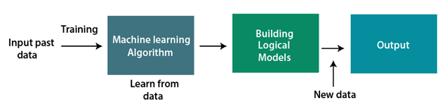
The below block diagram explains the working of Machine Learning algorithm:

Slide 20
Need for Machine Learning
The need for machine learning is increasing day by day. The reason behind the need for machine learning is that it is capable of doing tasks that are too complex for a person to implement directly. As a human, we have some limitations as we cannot access the huge amount of data manually, so for this, we need some computer systems and here comes the machine learning to make things easy for us.
We can train machine learning algorithms by providing them the huge amount of data and let them explore the data, construct the models, and predict the required output automatically. The performance of the machine learning algorithm depends on the amount of data, and it can be determined by the cost function. With the help of machine learning, we can save both time and money.
The importance of machine learning can be easily understood by its uses cases, Currently, machine learning is used in Medical diagnosis, self-driving cars, cyber fraud detection, face recognition, and friend suggestion by Facebook, etc. Various top companies such as Netflix and Amazon have build machine learning models that are using a vast amount of data to analyze the user interest and recommend product accordingly.

Slide 21
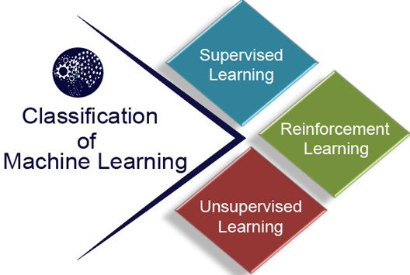
Classification of Machine Learning
At a broad level, machine learning can be classified into three types:
Supervised learning
Unsupervised learning
Reinforcement learning

Slide 22
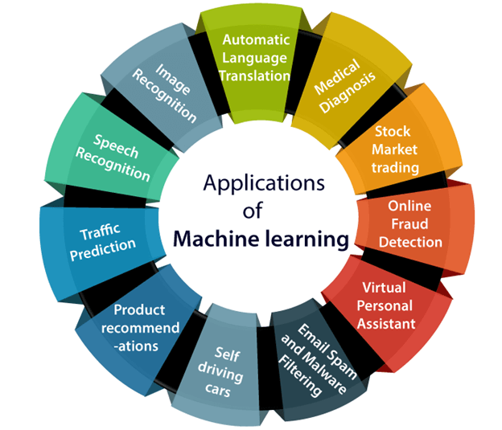
Applications of Machine learning
Machine learning is a buzzword for today's technology, and it is growing very rapidly day by day. We are using machine learning in our daily life even without knowing it such as Google Maps, Google assistant, Alexa, etc.
Below are some most trending real-world applications of Machine Learning:

Slide 23
Machine learning Life cycle
Machine learning has given the computer systems the abilities to automatically learn without being explicitly programmed. But how does a machine learning system work? So, it can be described using the life cycle of machine learning. Machine learning life cycle is a cyclic process to build an efficient machine learning project. The main purpose of the life cycle is to find a solution to the problem or project.
Machine learning life cycle involves seven major steps, which are given below:
Gathering Data
Data preparation
Data Wrangling
Analyse Data
Train the model
Test the model
Deployment

Slide 24
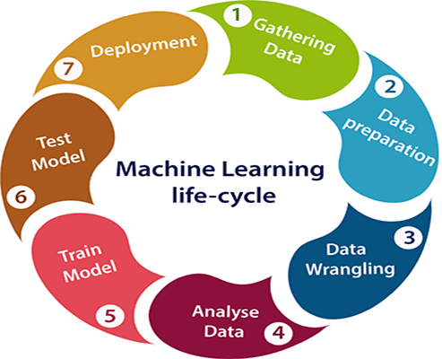
In the complete life cycle process, to solve a problem, we create a machine learning system called "model", and this model is created by providing "training". But to train a model, we need data, hence, life cycle starts by collecting data.

Slide 25
Proposed Methodology
Plan of Work:
Collection of data.
In-depth analysis of earlier papers which are closest with this work for executing the proposed study.
Design a model using Machine Learning Techniques.
On the basis of model, analysis will be done & result will be shown.

Slide 26
Methodology
Process 1: Data Collection
The dataset can be fetched from OASIS, ADNI and KAGGLE Repository.
Dataset Attributes / Features:
S.No. Attributes Description
1 ID Identification
2 M/F Gender (M if Male, F if Female)
3 Hand Handedness
4 Age Age in years
5 EDUC Years of education
6 SES Socio Economic Status
7 MMSE Mini Mental State Examination
8 CDR Clinical Dementia Rating
9 eTIV Estimated Total Intracranial Volume
10 nWBV Normalize Whole Brain Volume
11 ASF Atlas Scaling Factor
12 Delay Delay

Slide 27
Process 2: Pre-processing of Data
As raw data is highly susceptible to noise, missing values, and inconsistency, the data has to be pre-processed to make it a consistent data thus improving the quality of data and thereby resulting in accurate and reliable results.
Process 3: Feature Selection
Feature selection methods are intended to reduce the number of input variables to those that are believed to be most useful to a model in order to predict the target variable. Feature selection is achieved by eliminating irrelevant features. This can be performed by embedded technique. These techniques are designed in such a way that they are intelligently programmed for selecting the required features. Unlike wrapper method the embedded feature selection method is less complex and computationally expensive moreover it has lesser possibility to encounter with overfitting problem unlike filter method.

Slide 28
Process 4: Data Splitting
Building a machine-learning model requires splitting the data into training and testing sets. In the following data preparation step, the training data were used to create a model, which was then applied to test data to predict Alzheimer’s Disease. The model was trained from training set data, and test set data were used to test unseen data. Cross-validation was carried out by dividing the dataset into three subsets. Model predictions are made using one subset of the data (test data) and model performance is evaluated using the other subsets (training and validation) of the data. The data had been pre-processed, and we randomly divided it into an 80:20 ratio, with 80% going to training and 20% gone to testing.
Process 5: Model Training
The ML model is trained for every iteration with the n-1 divisions. The performance of the method is analyzed by the mean of all n-folds. In this work, the ML model was trained and tested 10 times by applying ten-fold cross validation to the model.

Slide 29
Process 6: Model Validation
Model validation reduces the overfitting problem. Cross Validation is done to train the ML model and are used to calculate the accuracy of the model. It is a challenging task to make the ML model from noise free. Hence, in this research work, Cross validation is performed which divides the whole dataset into n divisions which is of equal in size.
Process 7: Model Prediction
Voting is one of the simplest ways of combining the predictions from multiple earning algorithms. Voting classifiers aren’t actually classifiers but are more like wrappers for multiple ones that are trained and evaluated concurrently in order to benefit from their specific characteristics. We can train data sets using different algorithms and ensembles then to predict the final output. There are two ways to reach a majority vote on a prediction: Hard voting: The simplest form of majority voting is hard voting. The class with the most votes (Nc) will be chosen in this case. Our prediction is based on the majority vote of each classifier. Soft voting: This involves adding up the probability vectors for each predicted class (for all classifiers) and choosing the one that represents the highest value (recommended only when the classifiers are well calibrated).

Slide 30
Proposed Work Flow Diagram
Dataset
Model Training and Evaluation
Data Preprocessing
Model Validation
Model Prediction
Feature Selection
Performance
Evaluation
Data Splitting

Slide 31
Process 9: Analysis
Accuracy: Accuracy in classification issues is the quantity of right expectations made by the model over different sorts forecasts made.
Precision: Precision is a measure that reveals to us what extent of patients that we analyzed as having Alzheimer's, really had Alzheimer's.
Recall or Sensitivity: Recall is a measure that implies what percentage of victims that really had Alzheimer's was detected by the algorithm as having Alzheimer's.
Specificity: Specificity is a measure that discloses to us what number of patients that didn't have Alzheimer's, were anticipated by the model as non-Alzheimer.
F1 Score: We would prefer truly not to convey both Precision and Recall in our toolbox each time we make a model for tackling a classification issue. So it's ideal in the event that we can get a solitary score that sort of speaks to both Precision (P) and Recall(R). One approach to do that is essentially taking their arithmetic mean. For example (P + R)/2 where P is Precision and R is Recall.
The result will be expressed in analytical and graphical form.

Slide 32
Expected Outcomes
In this proposed work, an effective early diagnosis of Alzheimer’s Disease can be done using Machine Learning Models.
The proposed model will evaluate the performance of the existing model and provide a new model.

Slide 33
References
[1] Dinu A.J., Ganesan R. (2019). Early detection of Alzheimer's disease using predictive k-NN instance-based approach and T-Test Method, ISSN 2278-3091 Volume 8, No.1.4, International Journal of Advanced Trends in Computer Science and Engineering Available Online at http://www.warse.org/IJATCSE/static/pdf/file/ijatcse0581.42019.pdf https://doi.org/10.30534/ijatcse/2019/0581.42019
[2] William Thies, Laura Bleiler (2018). “Alzheimer’s disease facts and figures”, Alzheimer’s De-mentia, 14(3), 367–429. doi:10.1016/j.jalz.2018.02.001, .
[3] Gokce UYSAL and Mahmut OZTURK (2019). Using Machine Learning Methods for Detecting Alzheimer’s Disease through Hippocampal Volume Analysis, “978-1-7281-2420-9/19/$31.00 ©IEEE”
[4] Shah and et al (2020). Early Detection of Alzheimer’s Disease Using Various Machine Learning Techniques: A Comparative Study, Proceedings of the Fourth International Conference on Trends in Electronics and Informatics (ICOEI) IEEE Xplore Part Number: CFP20J32-ART; ISBN: 978-1-7281-5518-0

Slide 34
[4] William Thies, Laura Bleiler (2018). “Alzheimer’s disease facts and figures”, Alzheimer’s De-mentia, 14(3), 367–429. doi:10.1016/j.jalz.2018.02.001, .
[5] Gokce UYSAL and Mahmut OZTURK (2019). Using Machine Learning Methods for Detecting Alzheimer’s Disease through Hippocampal Volume Analysis, “978-1-7281-2420-9/19/$31.00 ©IEEE”
[6] Shah and et al (2020). Early Detection of Alzheimer’s Disease Using Various Machine Learning Techniques: A Comparative Study, Proceedings of the Fourth International Conference on Trends in Electronics and Informatics (ICOEI) IEEE Xplore Part Number: CFP20J32-ART; ISBN: 978-1-7281-5518-0

Slide 35
[7] Md. Ariful Islam Khan et al., (2019). Early Detection of Alzheimer’s Disease using Machine Learning Techniques, International Journal of Advanced Research (IJAR), ISSN: 2320-5407, Int. J. Adv. Res. 7(11), 235-242.
[8] Aunsia Khan and Muhammad Usman (2015). Early Diagnosis of Alzheimer’s Disease using Machine Learning Techniques, In Proceedings of the 7th International Joint Conference on Knowledge Discovery, Knowledge Engineering and Knowledge Management (IC3K 2015) - Volume 1: KDIR, pages 380-387 ISBN: 978-989-758-158-8
[9] Arpita Raut and Vipul Dalal (2017). A Machine Learning Based Approach for Detection of Alzheimer’s Disease Using Analysis of Hippocampus Region from MRI Scan, Proceedings of the IEEE 2017 International Conference on Computing Methodologies and Communication (ICCMC), 978-1-5090-4890-8/17.

Slide 36
[10] Ibrahim Almubark et al., (2019). Early Detection of Alzheimer’s Disease Using Patient Neuropsychological and Cognitive Data and Machine Learning Techniques, IEEE International Conference 978-1-7281-0858-2/19 , pp 5971-5973.
[11] S. Naganandhini and P. Shanmugavadivu (2019) Effective Diagnosis of Alzheimer’s Disease using Modified Decision Tree Classifier, International Conference on Recent Trends in Advanced Computing (ICRTAC 2019) 10.1016/j.procs.2020.01.049 pp 548-555.
[12] Sivakani. R and Gufran Ahmad Ansari (2020) Machine Learning Framework for Implementing Alzheimer’s Disease, International Conference on Communication and Signal Processing 978-1-7281-4988-2/20/$31.00 ©2020 IEEE, pp 0588 -0592.

Slide 37
[13] J. Neelaveni and M.S.Geetha Devasana (2020) Alzheimer Disease Prediction using Machine Learning Algorithms, 2020 6th International Conference on Advanced Computing & Communication Systems (ICACCS) 978-1-7281-5197-7/20/ ©2020 IEEE.
[14] Srinivasan Aruchamy et al., (2020) Alzheimer’s Disease Detection using Machine Learning Techniques in 3D MR Images, June 28,2020 at 13:18:22 UTC from IEEE Xplore.
[15] M. Tanveer et al., (2020) Machine learning techniques for the diagnosis of Alzheimer’s disease: A review. ACM Trans. Multimedia Comput. Commun. Appl. 16, 1s, Article 30 (April 2020), 28 pages. https://doi.org/https://doi.org/10.1145/3344998.
[16] Lucia Billeci et al., (2020) Machine Learning for the Classification of Alzheimer’s Disease and Its Prodromal Stage Using Brain Diffusion Tensor Imaging Data: A Systematic Review. Processes September 2020, 8, 1071; doi:10.3390/pr8091071.

Slide 38
[17] Elyas Irankhah (2020) Evaluation of Early Detection Methods for Alzheimer's Disease, Bioprocess Engineering. Vol. 4, No. 1, 2020, pp. 17-22. doi: 10.11648/j.be.20200401.13.
[18] Shweta Madiwalar et al., (2020) Classification and Investigation of Alzheimer Disease Using Machine Learning Algorithms. Biosc.Biotech.Res.Comm. Special Issue Vol 13 No 13 (2020) Pp-15-20. Doi: http://dx.doi.org/10.21786/bbrc/13.13/3.
[19] C. Kavitha et al., (2022) Early-Stage Alzheimer's Disease Prediction Using Machine Learning Models, Front. Public Health, 03 March 2022 | https://doi.org/10.3389/fpubh.2022.853294.

Slide 39
Thank You

